Slide 1

DL Meeting Paper Survey
2020/6/29
徐靖憲
電機通訊學院英語學士班 3A

Slide 2
Early Detection of Injuries in MLB Pitchers from Video
AJ Piergiovanni and Michael S. Ryoo
Department of Computer Science, Indiana University, Bloomington, IN 47408
{ajpiergi,mryoo}@indiana.edu
5th International Workshop on Computer Vision in Sports (CVsports) at CVPR 2019

Slide 3

=> Ski, Football, Table tennis, Soccer*3, Ice-Hockey, Basketball

Slide 4
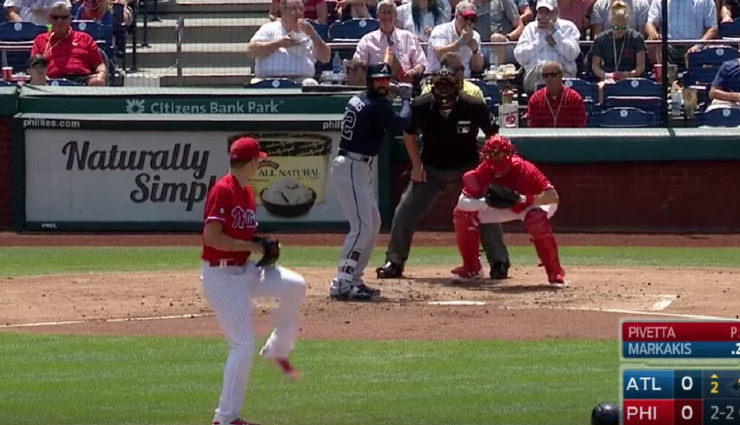
Introduction
In the MLB, teams spend an average of $450 million on players on the disabled list and an additional $50 million for replacement
players each year, an annual average $500 million per year
Pitching is a repetitive action; starting pitchers
throw roughly 2500 pitches per-season in games.

Slide 5
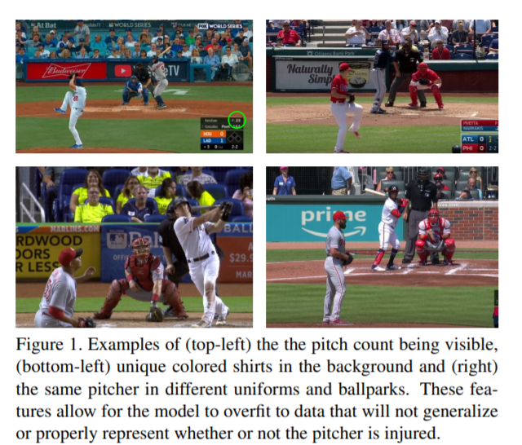
Data collection
We then collect videos of the TV broadcast of pitchers from
Several games not near the date of injury as well as the game
they were injured in. It contains injuries from 20 different
pitchers, 4 of which had multiple injuries in the same season.
The data contains 12 left-handed pitchers and 8 right-handed pitchers, 10 different injuries. There are 5479 pitches images in the dataset, 469 injured pitches and 5010 healthy pitches

Slide 6
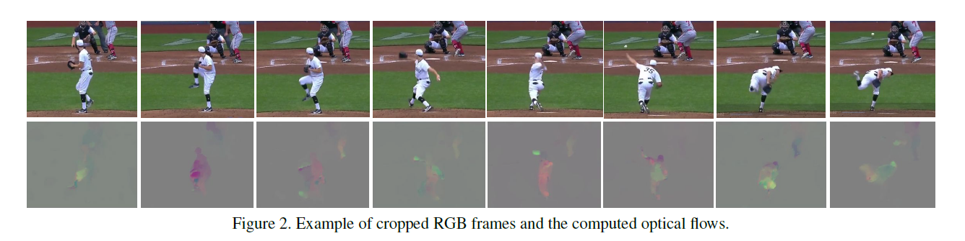
We first crop the videos to a bounding box containing just the pitcher. We then convert the images to greyscale and compute optical flow, as it capture high-resolution motion information while being invariant to appearance (i.e., jersey, time of day, etc.).

Slide 7
Models
Using standard 3D spatio-temporal CNN I3D (Two-Stream Inflated 3D ConvNets) trained on the optical flow frames.
Frames as input with resolution of 460x600 (cropped to just the pitcher from 1920x1080 video)
from a 10 second clip of a pitch at 60 fps.

Slide 8
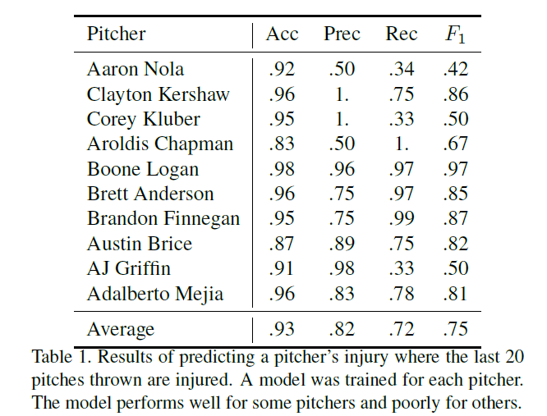
Injury Experiments 1- Last 20 pitches thrown
Results of predicting a pitcher’s injury where the last 20 pitches thrown are injured. A model was trained for each pitcher

Slide 9
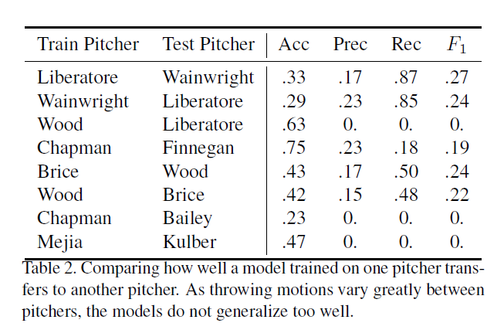
Injury Experiments 2- How well a model trained on one pitcher transfers to another pitcher.
To determine how well the models generalize, we evaluate the trained models on a different pitcher
Notes:
Same injury

Slide 10
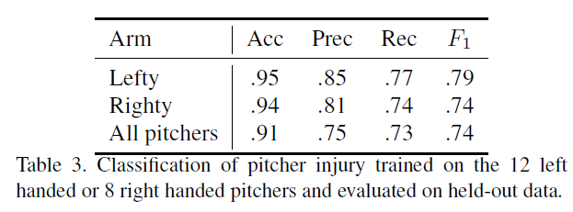
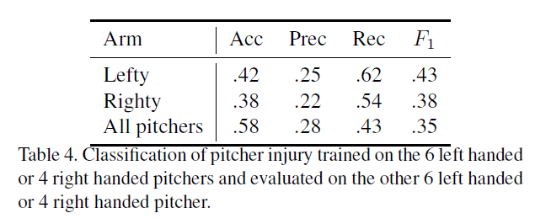
Injury Experiments 3- By pitching arm
Testing: same pitcher as training
Testing: different pitcher as training
Generalization: This suggests that models will be unable to predict injuries for pitchers they have not seen before.

Slide 11
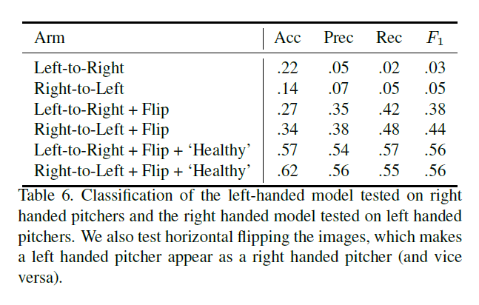
Injury Experiments 4- Lefty vs Righty Models
Classification of the left-handed model tested on right handed pitchers and the right handed model tested on left handed pitchers
We also try horizontally flipping the input images, effectively making a left handed pitcher appear as a right handed pitcher (and vice versa).

Slide 12
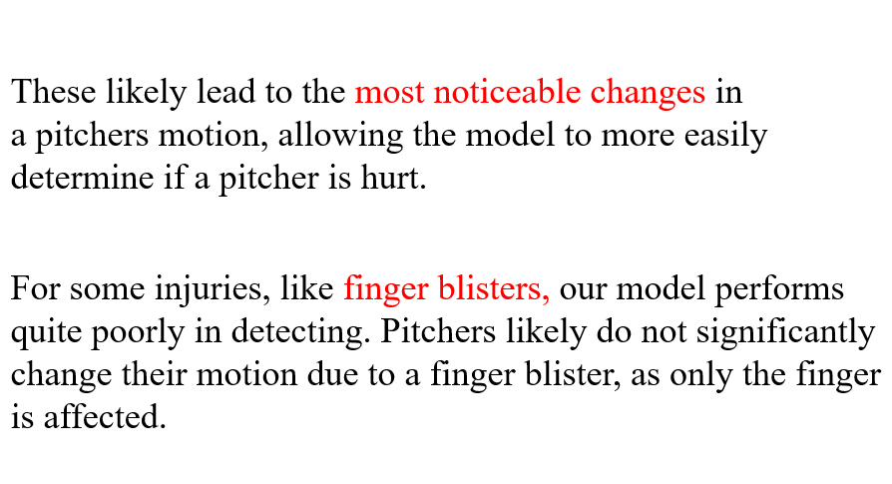
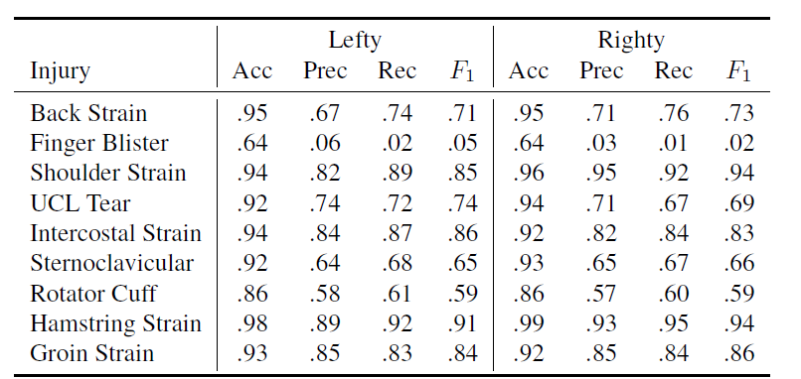
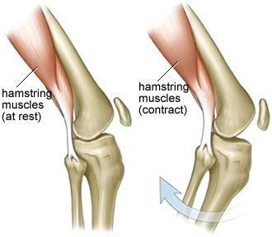
Experiments 5- Analysis of Injury Type
we train a separate model for left-handed and right-handed pitchers
Our model performs quite well for most injuries, especially hamstring and back injuries.
Table 7. Evaluation of the model for each injury. The model is able to detect some injuries well (e.g., hamstring strains) and others quite poorly (e.g., finger blisters).

Slide 13

Conclusion/ Discussion
1. While we showed that CNN can reliably detect and predicted injuries, due to the somewhat limited size of our dataset and scarcity of injury data in general, it is not clear exactly how
well this will generalize to all pitchers, or pitchers at different levels of baseball
2. While optical flow provides a reasonable input feature, it does lose some detail information which could be beneficial for injury detection. As many injuries in pitchers are due to overuse,
Representing an injury as a sequence of pitches could be beneficial, rather than treating each pitch as an individual event
3. Accurate injury prediction could use EMG

